Slide 1
APEX DAQ rate capability
April 19th 2015
Alexandre Camsonne

Slide 2
Outline
HRS
Channel count
Trigger rates
Triggers
Deadtime using 3 crates
TDC sparsicification
Sci Fi readout
Possible upgrades
FADC
TDC
Event blocking

Slide 3
HRS Detectors
S2m
16 Paddles
S1 ?
S0
2 PMTs
VDC
RHRS
Calorimeter
Total 4 layers
368 wires each
2 segmented layers of lead glass blocks
Gas Cherenkov
Central Ray
10 PMTs
Notes:
Scintillators used for timing and triggers
Left HRS
34 blocks in each layer
15x15x30cm dimensions
Right HRS
48 blocks in preshower
10x10x35cm dimensions
75 blocks in shower
15x32.5x15cm dimensions
Used for PID
Right arm GC used as part of trigger to achieve pion rejection on trigger level

Slide 4
Detector channels
Detector | Detector Channels | DAQ channels
Gas Cherenkov | 10 | 10 time 10 amplitude
Scintillators | 16+1 | 34 time 34 amplitude
Calorimeter | 128 – RHRS 68 – LHRS | 128 amplitude 68 amplitude
VDC | 1472 | 1472 time
LHRS
112 amplitude channels – 2 ADC modules
1516 time channels – 16 TDC modules
RHRS
172 amplitude channels – 3 ADC modules
1516 time channels – 16 TDC modules

Slide 5
Trigger rate
Setting | A | B | C | D
Energy (GeV) | 2.2 | 4.4 | 1.1 | 3.3
e⁻ (kHz) | 4500 | 700 | 6000 | 2900
π⁻ (kHz) | 100 | 2200 | 36 | 1000
e⁺ (kHz) | 31 | 3.6 | 24 | 23
π⁺ (kHz) | 100 | 2200 | 36 | 1000
Possible Improvements
Trigger
Reduce coincidence timing
Suppress pions
DAQ
Using of sparsification

Slide 6
Trigger Logic
Electron Arm Trigger (T1)
Electron S2m
Positron Arm Trigger (T3)
Positron S2m
Coincidence Trigger (T4)
Electron S2m + Positron S2m
“Golden” Coincidence Trigger (T6)
Electron S2m + Positron S2m + Positron Gas Cherenkov
Add muon trigger ?

Slide 7
Trigger rate
Setting | A | B | C | D
Energy (GeV) | 2.2 | 4.4 | 1.1 | 3.3
e⁻ (kHz) | 4500 | 700 | 6000 | 2900
π⁻ (kHz) | 100 | 2200 | 36 | 1000
e⁺ (kHz) | 31 | 3.6 | 24 | 23
π⁺ (kHz) | 100 | 2200 | 36 | 1000
T6 rate (kHz) 20ns window π⁺ rejection = 30 | 3.2 | 4.5 | 3.0 | 4.4
For 4 kHz DAQ dead time is 10%
APEX can run without any improvement to DAQ!

Slide 10
g2p

Slide 11
3 Crate configuration
LHRS
112 amplitude channels – 2 ADC modules
1516 time channels – 16 TDC modules
Crate 1: 5 TDC + 1 ADC
Crate 2: 5 TDC + 1 ADC
Crate 3: 6 TDC
RHRS
172 amplitude channels – 3 ADC modules
1516 time channels – 16 TDC modules
Crate 1: 5 TDC + 1 ADC
Crate 2: 5 TDC + 1 ADC
Crate 3: 6 TDC + 1 ADC
By reducing number of channels which go to each crate we reduce the amount of data to be recorded and improve dead time.

Slide 12
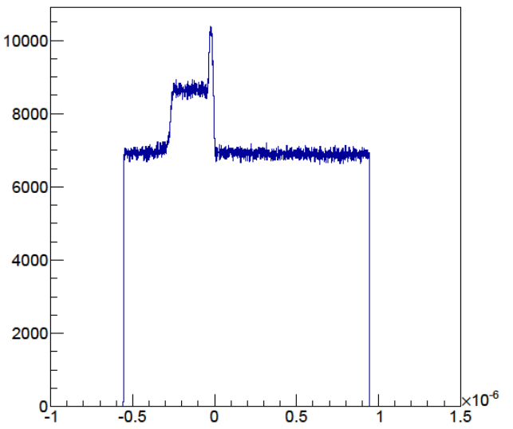
Sparsification
Typical TDC spectrum without sparsification. Only 300ns window out of 1.5µs full scale window has useful data
full- scale window
0-32 µs (8ns step)
Start from background
Common Stop
Start from signal
Sparsification
0-8µs
(0.5ns step)
Gate
Enabling of sparsification allows to significantly reduce event size. All TDC modules have been tested to work in sparsification mode.
To be implemented ( Kalyan )

Slide 13
SciFi Readout
4 FADC in each HRS
1 VME64X crate in each HRS
21 slots
Intel CPU readout
100 MB/s sustained rate ( 5 x faster than Fastbus )
Could add Cerenkov and other detectors if more FADCs

Slide 14
1881M
10 Megawords /s : 40 MB/s – 20 MB/s sustained
16 Hits/channel
Conversion time : 12 us 13 bit – 9 us 12 bit
AS-AK Handshake Time: 125 nsec typical, 150 nsec maximum. DS-DK Handshake Time: 65 nsec typical, 75 nsec maximum.

Slide 15
1877S
10 Megawords /s = 40 MB/s , 20 MB/s sustained
16 Hits/channel
Conversion time : 1.2 us + 50 ns/hit 1.75 us Min 7.6 us Max
Suppression : windows with steps of 8 ns
AS-AK Handshake Time: 125 nsec typical, 150 nsec maximum. DS-DK Handshake Time: 65 nsec typical, 75 nsec maximum

Slide 16
ADC channels on FADC
LHRS
112 amplitude channels – 7 ADC modules
1516 time channels – 16 TDC modules
Crate 1: 5 TDC
Crate 2: 5 TDC
Crate 3: 6 TDC
Crate 4: 7 + 4 FADC
RHRS
172 amplitude channels – 11 FADC modules
1516 time channels – 16 TDC modules
Crate 1: 5 TDC
Crate 2: 5 TDC
Crate 3: 6 TDC
Crate 4: 11+4 FADC fits in one crate
Gain from 1.4 us up to 7.25 us encoding depending on VDC occupancy
Deadtime dominated by VDC data transfer
26 FADCs ~ 130 K$
Might be able to borrow from JLab

Slide 17
Event size TDCs
4 x 368 = 1472 channels
368 = 4 TDCs
Cluster 5 wires = 2 + 5 = 7 words = 28 bytes
Time transfer crate block transfer :
50 us + 2 /16 * 5 = 51 us
Time transfer standard :
7 * ( 150 + 75 ) = 7 x 225 = 1.575 us
Block transfer saves time for more than 222 words

Slide 18
TDCs on VME
3 VME64X crates available from DVCS
3 VXS crates
Need 1472 channels for each HRS
CAEN 1190 : 12 TDCs = 120 K$
VETROC : 12 VETROC = 60 K$
F1 : 24 F1
Max 240 K$, can do 120 K$ with JLAB VETROC
Need 48 F1 ( most likely not enough )
Can mix F1 and VETROC
Improvement :
x2 with 1 crate 9 KHz
x4 with 2 crates 18 KHz

Slide 19
Event Blocking
Triggers
Overhead
Readout
Overhead
Readout
Overhead
Readout
Overhead
Readout
20µs 50µs 20µs 50µs 20µs 50µs 20µs 50µs
Readout time is 50 µs + 2 µs per 16 channel.
64 channels – 58 µs
128 channels – 66 µs
For one channel readout.
4 events no EB – 280 µs
4 events with EB – 220 µs
Triggers
Overhead
Readout
Readout
Readout
Readout
20µs 50µs 50µs 50µs 50µs

Slide 20
Event Blocking test results
20 kHz rate
New TI version 3
Linux CPU
Event Blocking | Number of channels | Number of modules | Life time (%)
1 | 1 | 1 | 71
4 | 1 | 1 | 90
1 | 64 | 3 | 65
4 | 64 | 3 | 80

Slide 21
Event blocking
Can improve up to 30 % deadtime
4.5 KHz to 5.8 KHz
Depends on rate and event size
Need 5 new TI for each HRS = 10 TI and new TS
If all VME and event blocking : up 200 KHz rate expected

Slide 22
Conclusion
Using TDC sparsification should reach 4.5 KHz with 10 % deadtime
Use of 3 fastbus crates helps reduce deadtime
Will try implement event blocking but needs hardware , testing and modification of analysis software
Optimize transfer depending on event size
Options for upgrade for some costs

